Slide 1

Tracking
CS 498VR: Virtual Reality
UNIVERSITY OF ILLINOIS AT URBANA-CHAMPAIGN
Eric Shaffer

Slide 2
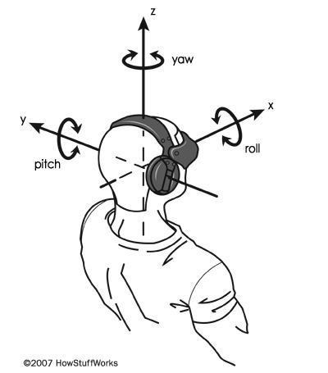
Tracking Systems in VR
Keeping track of motion in the physical world is a crucial part of any VR system.
Tracking was one of the largest obstacles to bringing VR headsets into consumer electronics,
Highly accurate tracking methods have been mostly enabled by commodity hardware components
Inertial measurement units (IMUs)
Cameras
These have plummeted in size and cost due to the smartphone industry
Notes:
Encourage people to think of things? Some examples are on the next slide

Slide 3
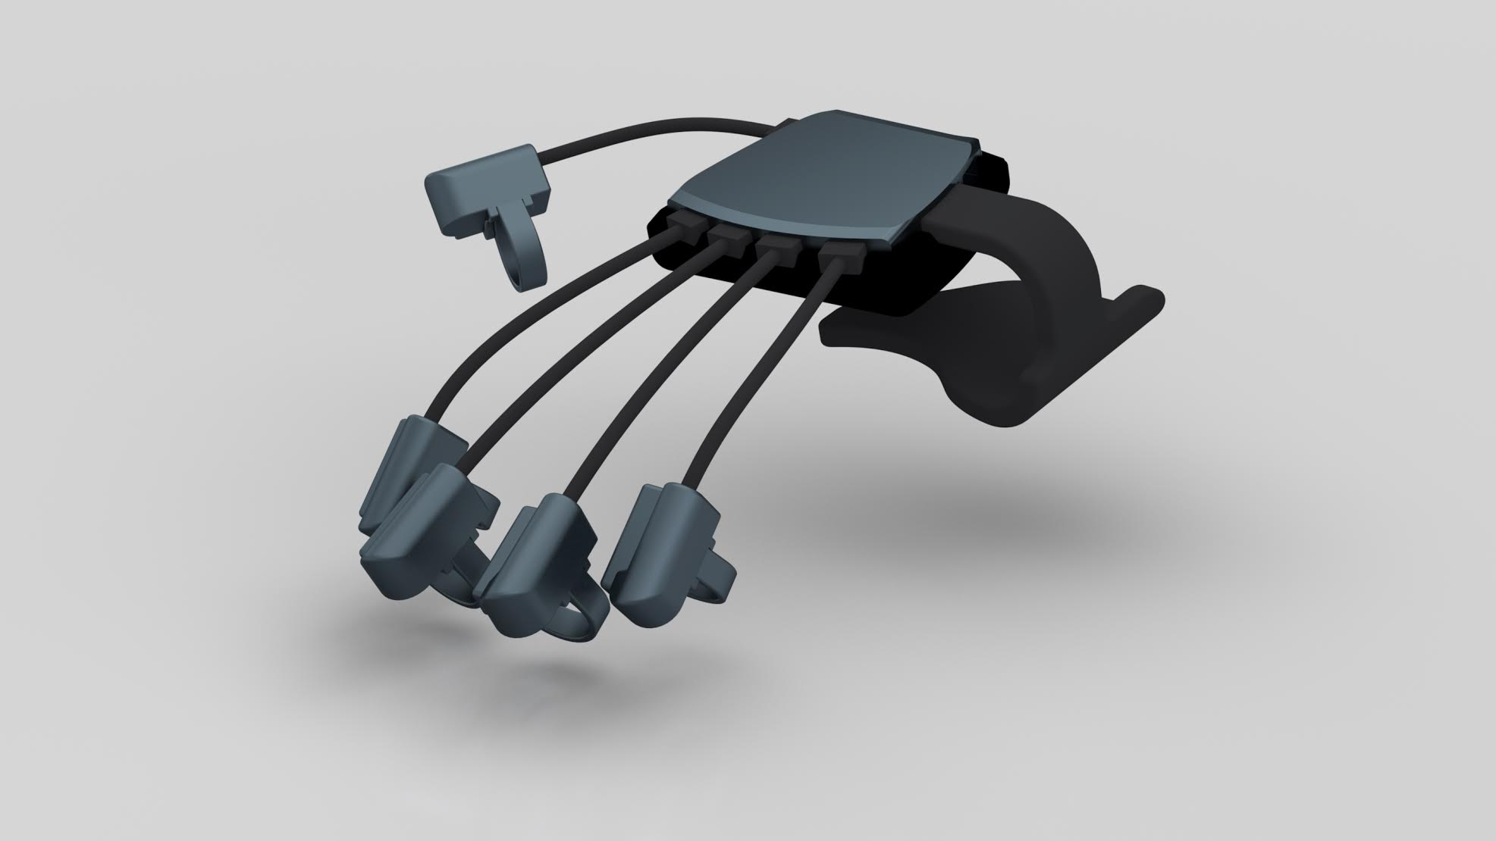
Things We Would Like to Track
What do we want to track? (Think of rigid bodies)
Head wearing HMD
Eyes
Palms of hands
Fingers
Entire body
Interactable objects - controller, coffee cup, desk...
Other people in the space
Notes:
“Entire body” as composed of rigid bodies -- track each individual body part to form the whole body

Slide 4
Tracking Rigid Bodies
We want to track 3D position and orientation over time
How can we store this information?

Slide 5
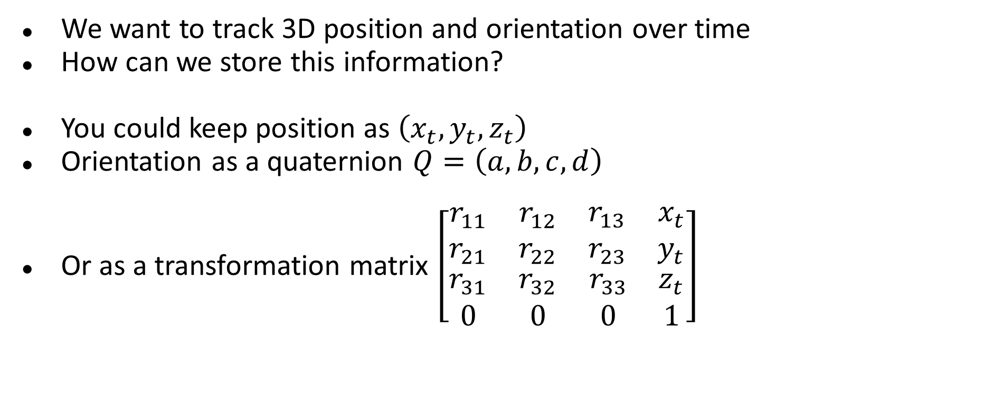
Tracking Rigid Bodies
We want to track 3D position and orientation over time
How can we store this information?
You could keep position as $\left(x_{t},y_{t},z_{t}\right)$
Orientation as a quaternion $Q=\left(a,b,c,d\right)$
Or as a transformation matrix $\left[\begin{matrix}\begin{matrix}r_{11} & r_{12} \\ r_{21} & r_{22}\end{matrix} & \begin{matrix}r_{13} & x_{t} \\ r_{23} & y_{t}\end{matrix} \\ \begin{matrix}r_{31} & r_{32} \\ 0 & 0\end{matrix} & \begin{matrix}r_{33} & z_{t} \\ 0 & 1\end{matrix}\end{matrix}\right]$
Google Cardboard Gear VR
Oculus HTC Vive

Slide 6
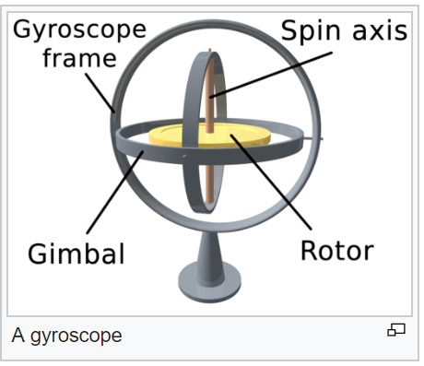
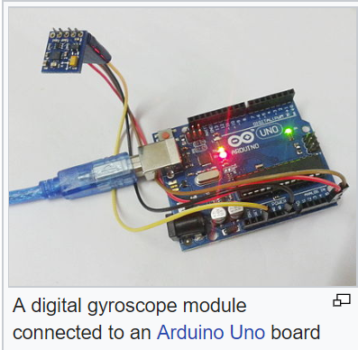
Gyroscope
Device that measures angular velocity
Measurement is an approximation to true angular velocity
Calibration error
Biggest reason for difference between true and measured values
Biggest difference between high quality IMU ($1000+) …and cheap IMU ($1)

Slide 7
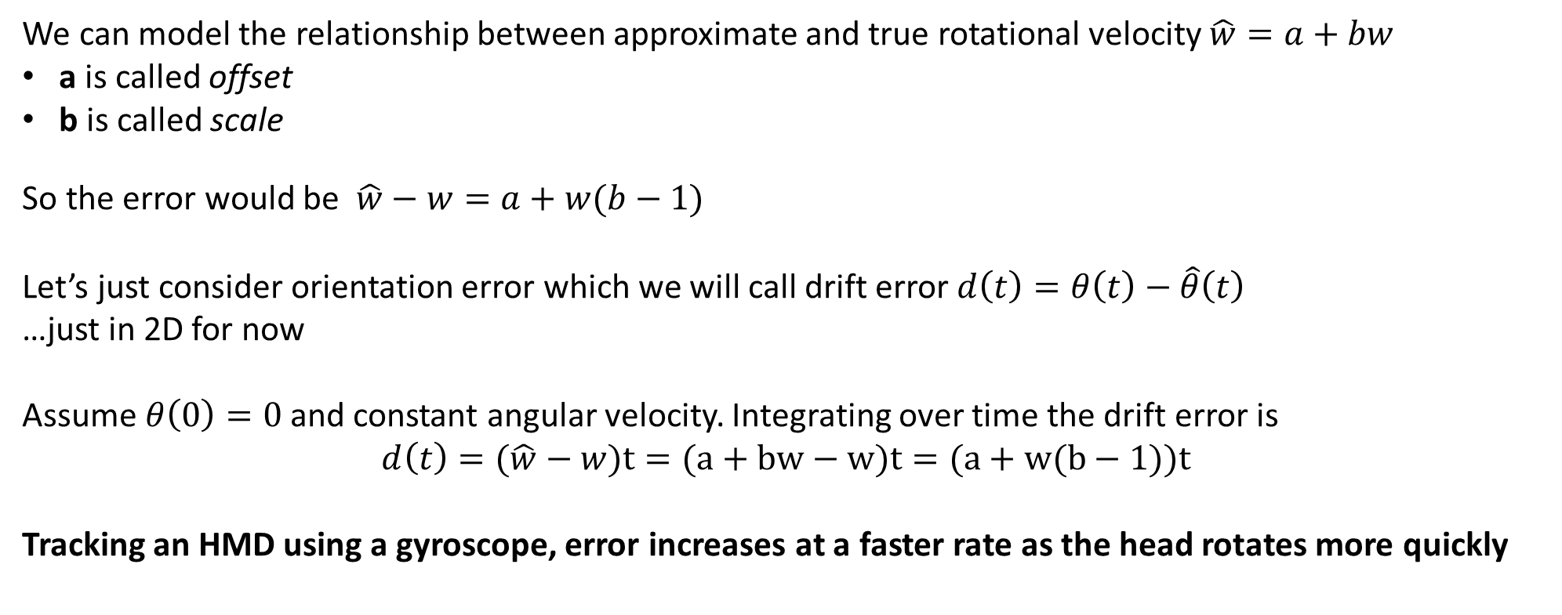
Drift Error
We can model the relationship between approximate and true rotational velocity $\hat{w}=a+bw$
a is called offset
b is called scale
So the error would be $\hat{w}−w=a+w(b−1)$
Let’s just consider orientation error which we will call drift error $d\left(t\right)=θ\left(t\right)−\hat{θ}\left(t\right)$
…just in 2D for now
Assume $θ\left(0\right)=0$ and constant angular velocity. Integrating over time the drift error is
$$d\left(t\right)=(\hat{w}−w)t=(a+bw−w)t=(a+w(b−1))t$$
Tracking an HMD using a gyroscope, error increases at a faster rate as the head rotates more quickly

Slide 8
Four Problems to Solve in Tracking
Calibration: adjust sensor values to remove error
Integration: orientation is estimated by integrating discrete measurements
Registration: initial orientation must be determined
Drift error: error grows over time and must be removed

Slide 9
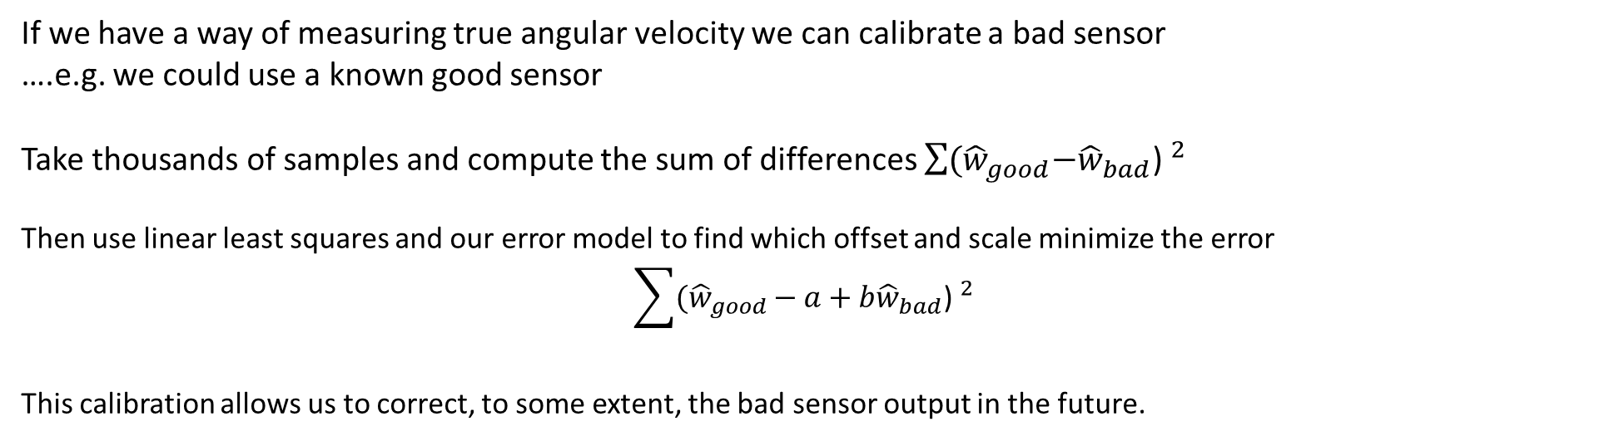
Calibration
Calibration is the process of configuring an instrument to provide a result for a sample within an acceptable range.
If we have a way of measuring true angular velocity we can calibrate a bad sensor ….e.g. we could use a known good sensor
Take thousands of samples and compute the sum of differences $\sum{{{(\hat{w}}_{good}−{\hat{w}}_{bad}\text{) }}^{2}}$
Then use linear least squares and our error model to find which offset and scale minimize the error $$\sum{{{(\hat{w}}_{good }− {a+b\hat{w}}_{bad}\text{) }}^{2}}$$
This calibration allows us to correct, to some extent, the bad sensor output in the future.

Slide 10
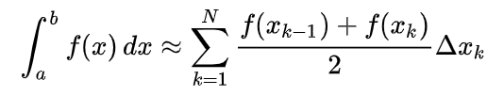
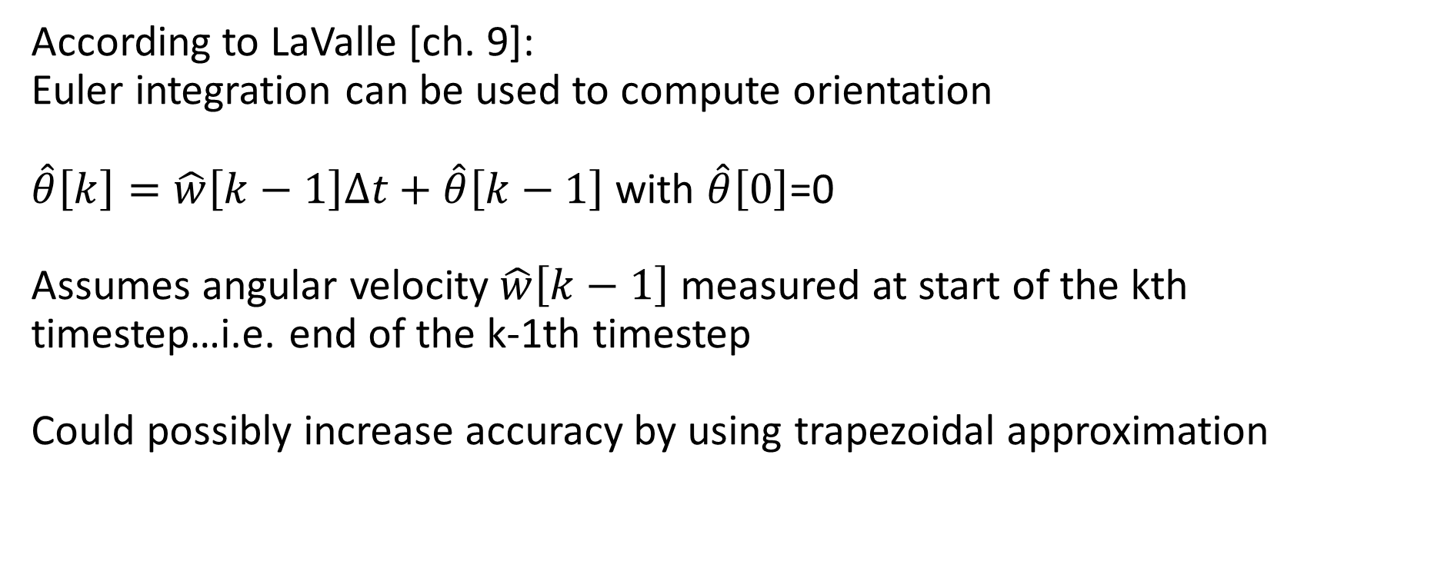
Integration
Rift gyroscope samples every 1ms yielding a 1000Hz sampling rate
According to LaValle [ch. 9]: Euler integration can be used to compute orientation $\hat{θ}\left[k\right]=\hat{w}\left[k−1\right]∆t+\hat{θ}\left[k−1\right]$ with $\hat{θ}\left[0\right]$=0
Assumes angular velocity $\hat{w}\left[k−1\right]$ measured at start of the kth timestep…i.e. end of the k-1th timestep
Could possibly increase accuracy by using trapezoidal approximation

Slide 11

Registration
Need to determine a initial forward direction
Can be whatever direction HMD is facing when booted …this can cause problems when switching HMD to a new user …can add ability to set forward to current facing direction
Can be a fixed direction in physical world e.g. towards Rift camera
In 3D, pitch and roll components align with gravity
World shouldn’t tilt…

Slide 12
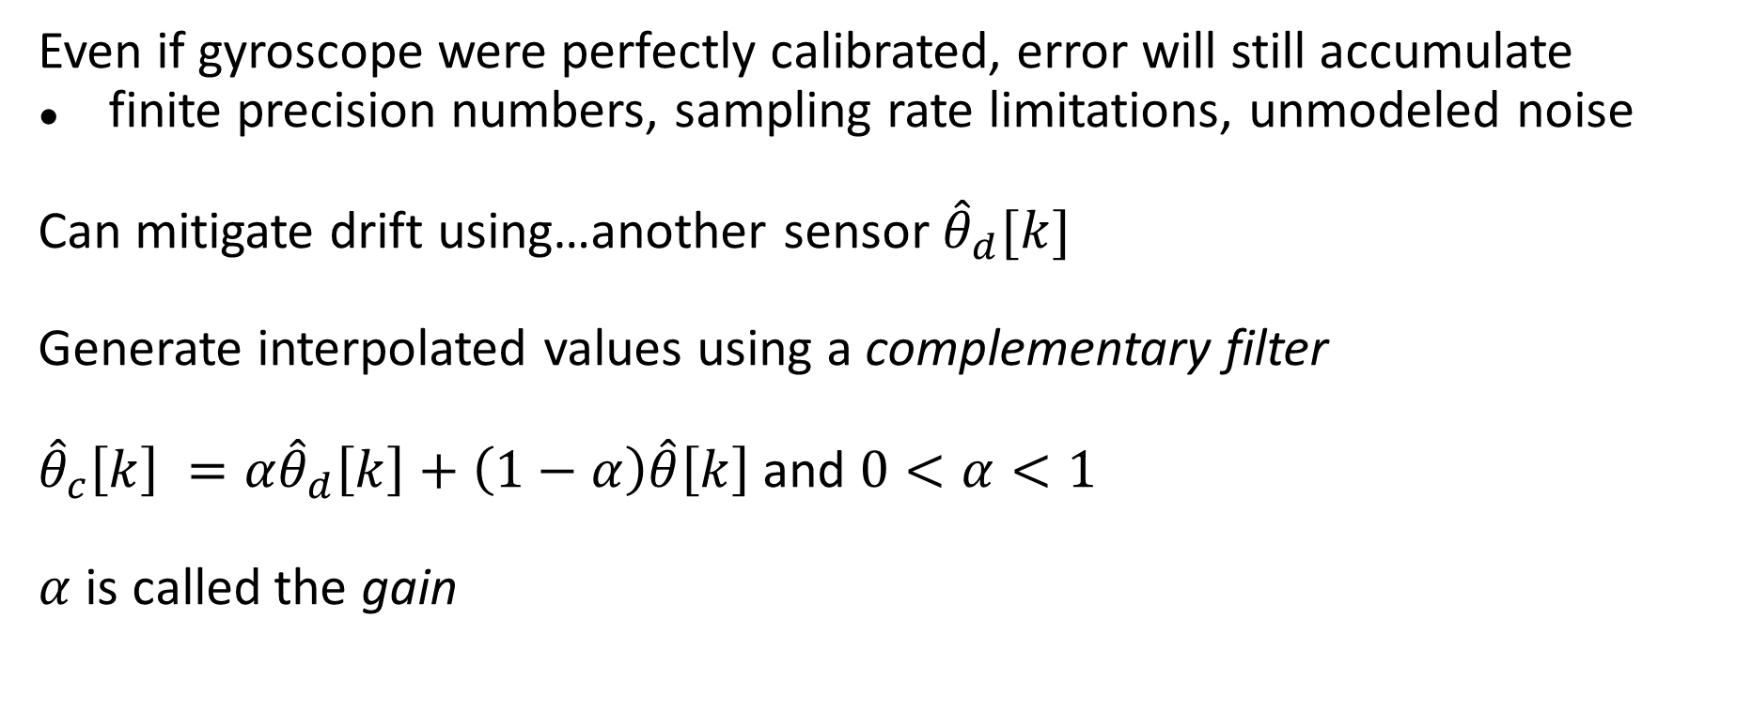
Drift Correction
Even if gyroscope were perfectly calibrated, error will still accumulate
finite precision numbers, sampling rate limitations, unmodeled noise
Can mitigate drift using…another sensor ${\hat{θ}}_{d}[k]$
Generate interpolated values using a complementary filter
${{\hat{θ}}_{c}\left[k\right] =α\hat{θ}}_{d}\left[k\right]+\left(1−α\right)\hat{θ}\left[k\right]$ and $0<α<1$
$α$ is called the gain

Slide 13
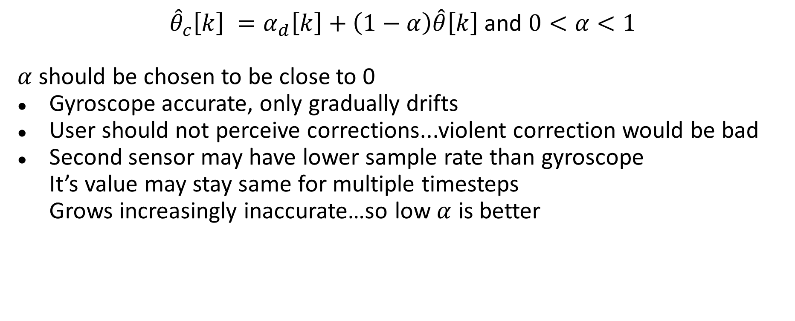
Drift Correction Considerations
${{\hat{θ}}_{c}\left[k\right] =α}_{d}\left[k\right]+\left(1−α\right)\hat{θ}\left[k\right]$ and $0<α<1$
$α$ should be chosen to be close to 0
Gyroscope accurate, only gradually drifts
User should not perceive corrections...violent correction would be bad
Second sensor may have lower sample rate than gyroscope It’s value may stay same for multiple timesteps Grows increasingly inaccurate…so low $α$ is better
The gain could be selected “optimally” by employing a Kalman filter; however, the optimality only holds if we have a linear stochastic system, which is not the case in human body tracking.

Slide 14
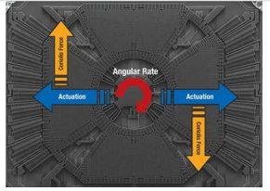
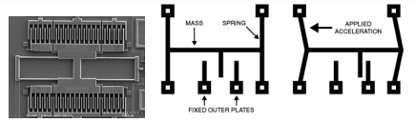
3D Orientation
IMUs are now microscopic MEMS circuits
Gyroscope: measure angular velocity around 3 orthogonal axes
Accelerometer: measure linear acceleration along 3 axes
Magnetometer: Measure magnetic field strength along 3 orthogonal axes

Slide 15
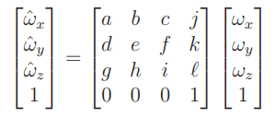
Calibration in 3D
MEMS elements may not be orthogonal…need to account for that error as well
Can fill out matrix using samples and linear least squares as before.
Works for gyroscope and accelerometers…magnetometers more complicated
May need to use different calibrations at different temperatures
What would matrix look like if we were assured of orthogonality?

Slide 16
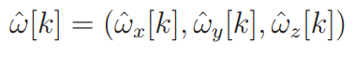
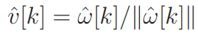
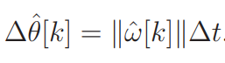
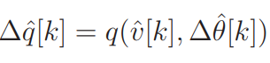
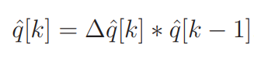
Integration in 3D
We have
We can express the change in orientation as a quaternion Axis: Angle:
Yields quaternion:
Orientation update becomes:

Slide 17
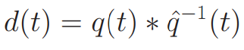
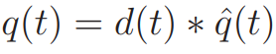
Drift Error in 3D
Drift error is a quaternion
What is this value if there is no error?
Note that applying the drift error to the estimate yields
We will decompose the error into 2 parts:
Tilt Error: The pitch and roll components
Yaw Error:…the yaw component

Slide 18
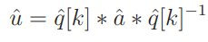
Tilt Error
We will detect and correct this using an “up sensor”
In practice, this is the accelerometer measuring the effect of gravity
Up vector reported in “body coordinates”
e.g. up starts at (0,1,0)…if body rolls 90 degrees it becomes (0,0,1)
Transform it into world coordinates by rotating by orientation quaternion
When transformed we should get (0,1,0)…..
Head Tracking for the Oculus Rift, IEEE International Conference on Robotics and Automation 2014, S. LaValle, A. Yershova, M. Katsev, M. Antonov

Slide 19
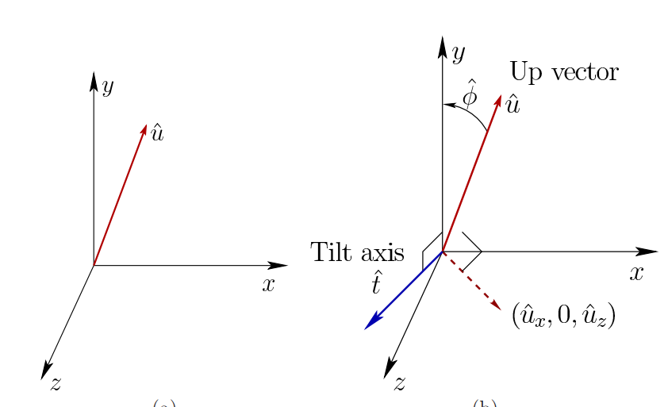
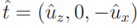
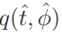
Correcting Tilt Error
Tilt error makes the transformed up vector not align with (0,1,0)
We can project the transformed vector onto the xz plane.
Tilt axis is then
We can rotate around the tilt axis to align the up vector and y axis...tilt error is

Slide 20
Correcting Tilt Error in Practice
Accelerometer reports all acceleration
…only trust it when upward magnitude is close to 9.8m² ?
In practice, use complex heuristics
Evaluating other sensor data
Rate of change of accelerometer

Slide 21
Yaw Error
Correct using a “compass” that generates a vector
In xz plane
Pointing “north”
Same correction mechanism as tilt
Vector is reported in body coordinates
Transform it to world coordinates
Measure deviation from (0,0,-1)…or whatever world “north” is…

Slide 22
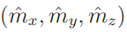
Correcting Yaw Error in Practice
Use magnetometer to measure a magnetic field vector
Vector doesn’t lie in horizontal plane…has an inclination angle
Can project to xz plane
Projected vector has declination angle deviating from true north
We can ignore this…why?
Finally, need to compensate for field distorting elements (iron) in HMD

Slide 23
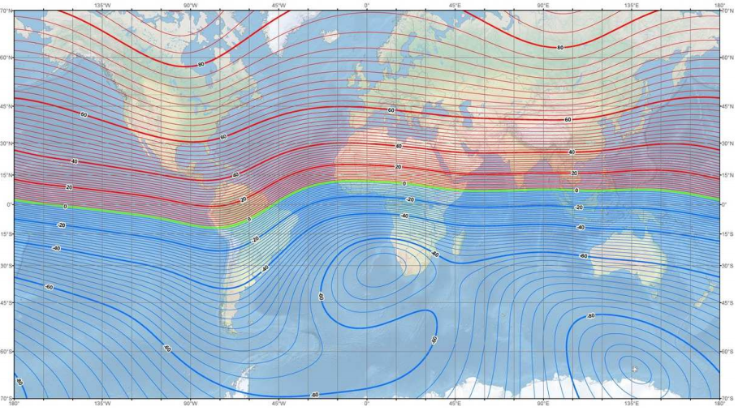
Correcting Yaw Error in Practice
Field vector is close to vertical in Finland…
Still can have problems…
If magnetic field vector is too close to vertical it’s useless
Some buildings distort the vector…that’s bad too

Slide 24
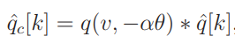
Filtering
Can filter like before…but on quaternions… We obtain the drift quaternion by multiplying tilt and yaw error quaternion
Before we used subtraction…now we multiply by a quaternion
Think of it as stepping in the direction of the correction by some small amount
Could also keep tilt and yaw separate and use separate gains

Slide 25
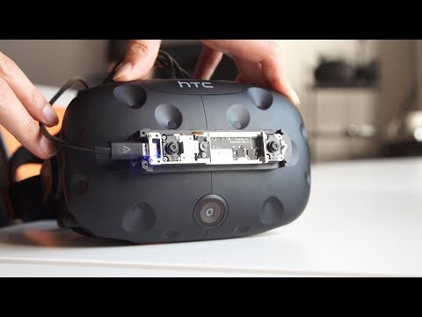
Inside-Out Tracking

Slide 26
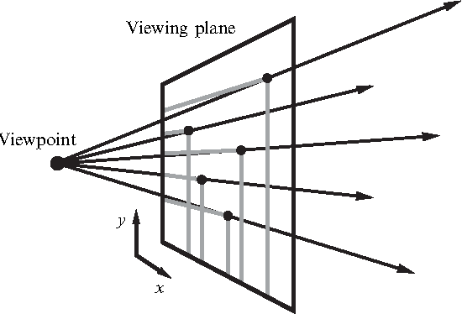
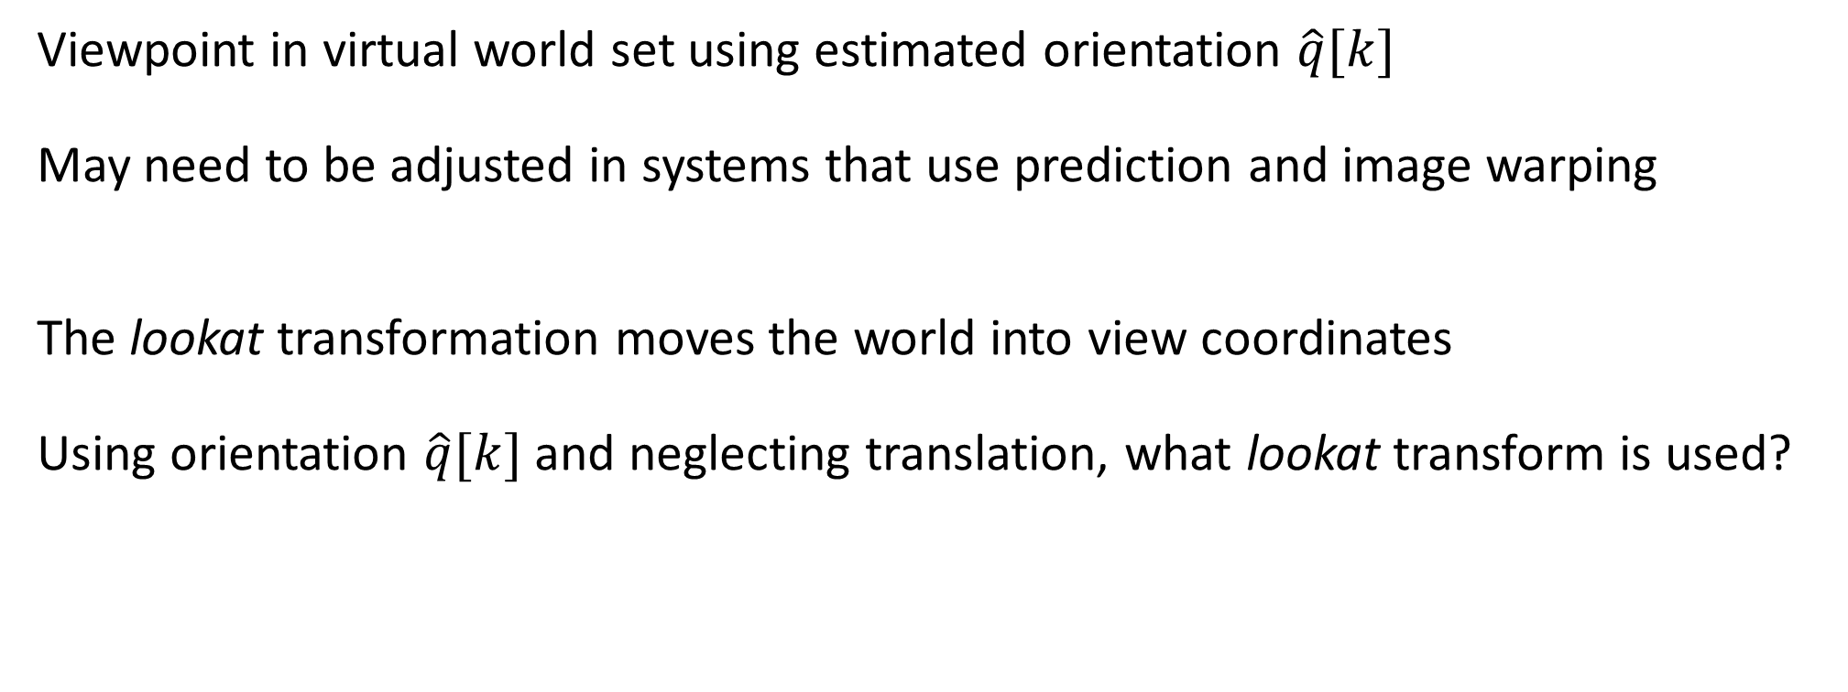
Setting the Viewpoint
Viewpoint in virtual world set using estimated orientation $\hat{q}[k]$
May need to be adjusted in systems that use prediction and image warping
The lookat transformation moves the world into view coordinates
Using orientation $\hat{q}[k]$ and neglecting translation, what lookat transform is used?
How does prediction work? Why is it used?

Slide 27
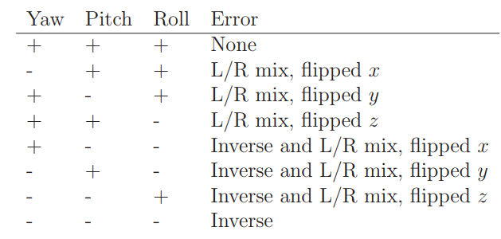
Debugging Tip
Connecting viewpoint to tracked orientation often done incorrectly
Can debug by testing rotations around 3 canonical axes
+ → world moves correctly
- → world moves opposite of correctly

Slide 28
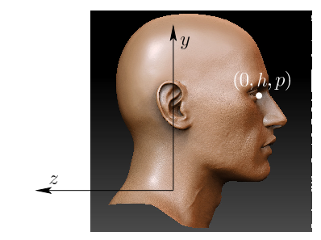
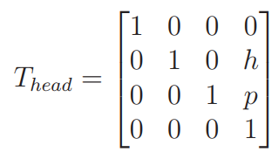
A Head Model
Virtual head height should be the same as in real world
Unless the experience is meant to be different (e.g. mouseworld)
As head rotates, eyes change positions
Let h and p be offsets to an eye measured from center of head rotation
Can apply head transformation before the lookat transform
h and p should then be formed to move world objects
This model was used in Samsung Gear VR….better solutions can be implemented using more sensors

Slide 29
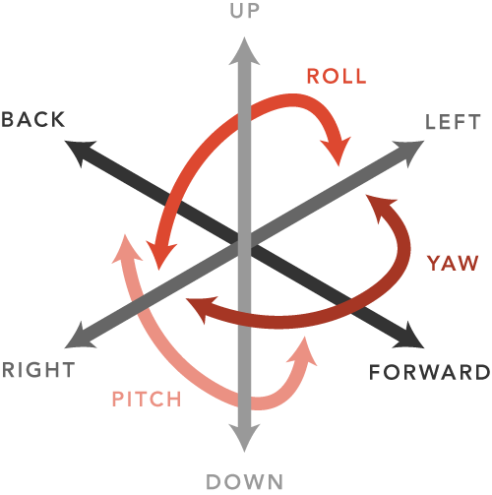
Tracking Position and Orientation
Now we will discuss tracking all 6 DOFs for a moving rigid body
We call the position + orientation the pose
Being able to track all 6DOFs means we don’t need a head model

Slide 30
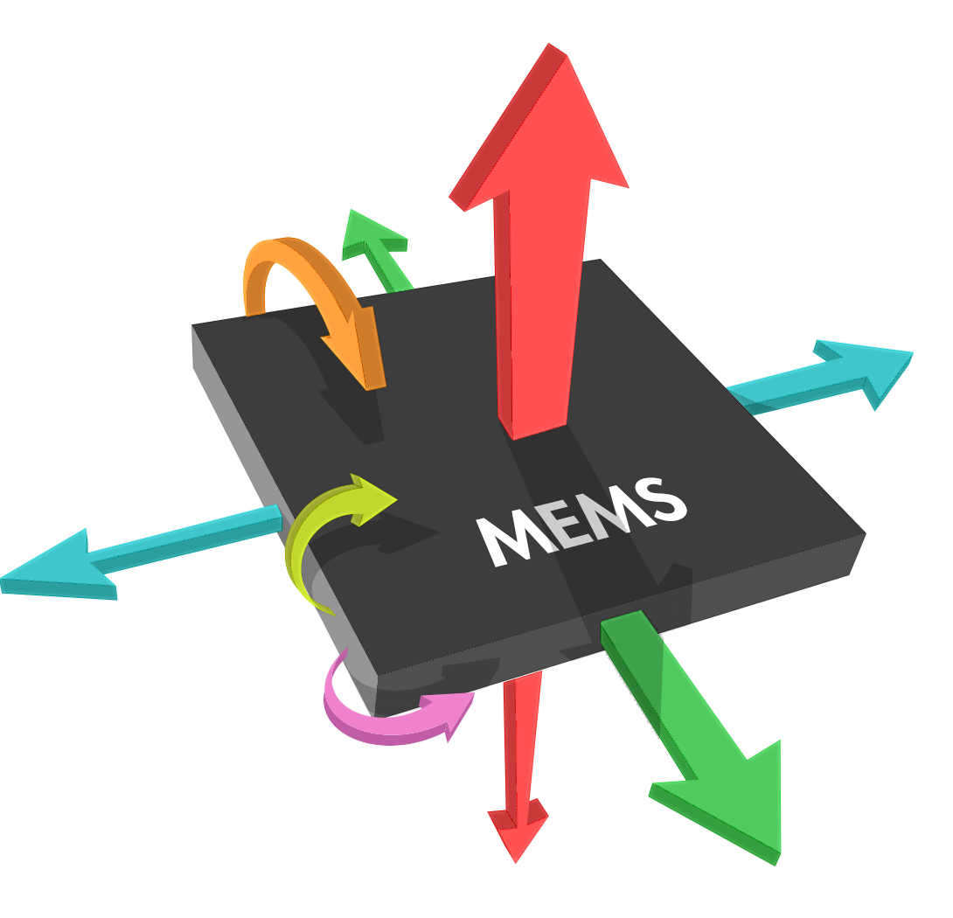
Integrate the Accelerometer?
We could subtract off acceleration due to gravity and find body acceleration…
What do we need to estimate position?
How does that contrast with using a gyroscope to compute orientation?
What is effect on the error?
Can the IMU sensors be used to correct positional drift error?

Slide 31
Integrate the Accelerometer?
What do we need to estimate position? Integrate twice
How does that contrast with using a gyroscope to compute orientation? Only a single integration is necessary to find orientation from angular velocity
What is effect on the error? Orientation error is linear in time. Positional would be quadratic in time.
Can the IMU sensors be used to correct positional drift error? No…can’t detect even constant velocity

Slide 32
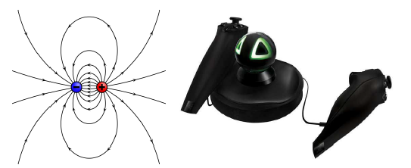
Active Tracking
Another approach is to create a signal to be sensed
Many approaches have been tried
Infrared
Ultrasound
Electromagnetic

Slide 33
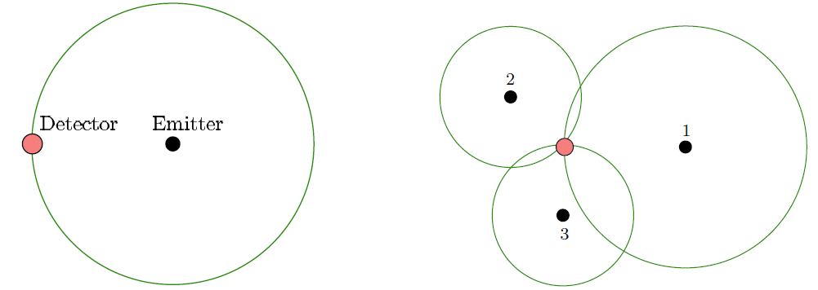
Trilateration
Consider something like ultrasound
Emitter is a speaker and detector is a microphone
Speaker emits at known time intervals…
Time of Flight (time to detection) enables computation of distance
Three emitters allow unique determination of location…

Slide 34
Sound and EM…and Visibility
Both kinds of systems have been problematic
Sound reflects off objects in the rooms leading multiple detections
Environment can warp EM fields and thus warp detected trajectories
Visibility approaches have been more robust
Camera can be used to track features
Oculus Rift system tracks infrared LEDs on the HMD

Slide 35
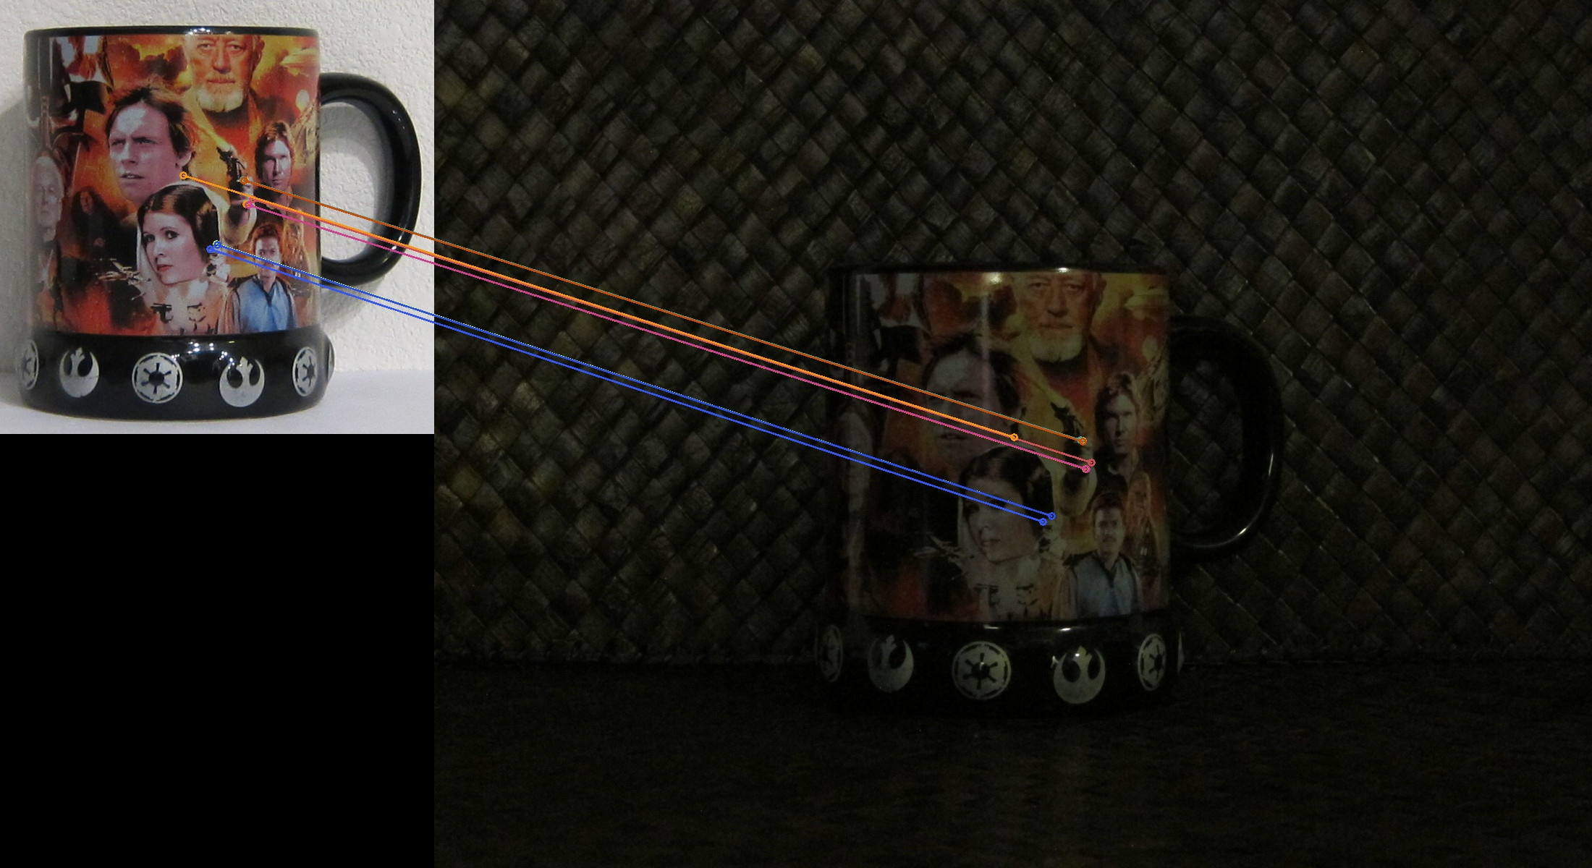
A Quick Guide to Features
Natural Features: Automatically discovered and labeled
Artificial Features: Engineered and placed in scene with assigned labels
Passive Features: Do not emit energy…can reflect energy (i.e. light)
Active Features: Emit light

Slide 36
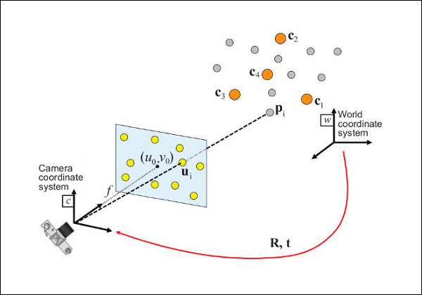
Perspective-n-Point Problem (PnP)
Using n-points on an object in an image, compute the pose matrix T_{rb}
Each observed point (i,j) in image coordinates eliminates 2 DOFs
For 3 points (i.e. P3P) 0 DOFs remain but solution is not unique
P6P required for unique solution
More than 6 points generally used to make solution robust to error

Slide 37
Camera-Based Implementation
We can either
Have a fixed camera and moving features (Rift)
Have a moving camera and fixed features

Slide 38
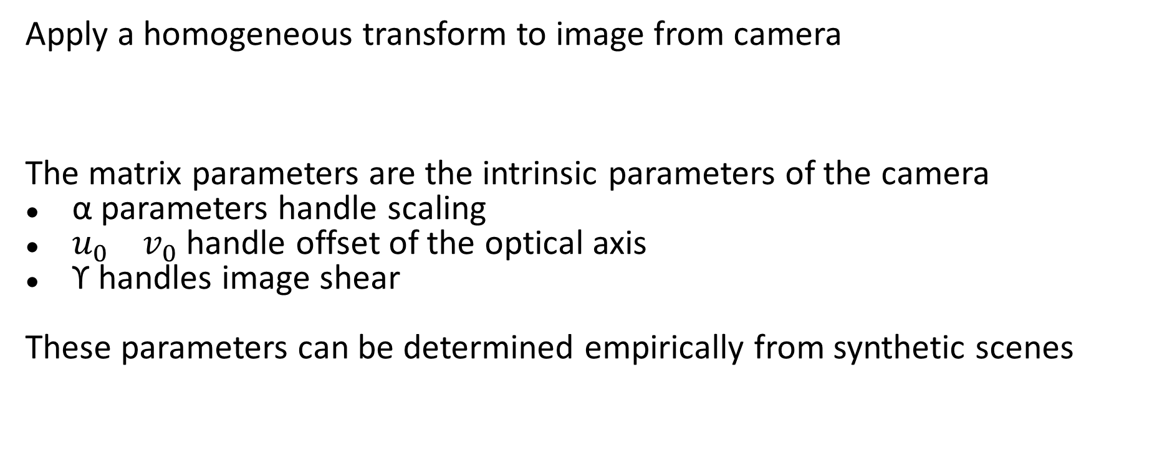
Camera Calibration
Apply a homogeneous transform to image from camera
The matrix parameters are the intrinsic parameters of the camera
α parameters handle scaling
$u_{0} v_{0}$handle offset of the optical axis
ϒ handles image shear
These parameters can be determined empirically from synthetic scenes

Slide 39
Laser-Based-Implementation
Lighthouse HTC Vive tracking is an example
Lighthouse has spinning drum emitting vertical and horizontal IR light
Photodiodes on HMD detect IR light

Slide 40
Laser-Based-Implementation
Horizontal light determines pixel column of feature coordinate
Vertical light determines pixel row of feature coordinates
Multiple base stations needed to compute distance from feature to station

Slide 41
Filtering
IMU frequency is much higher than camera usually…so it is useful to use it
Orientation can be computed using camera and IMU together to reduce error
Camera optical axis can be used to estimate yaw error (replacing magnetometer)
If camera tilt is known, it can be used to provide tilt error estimation (replacing accelerometer)

Slide 42
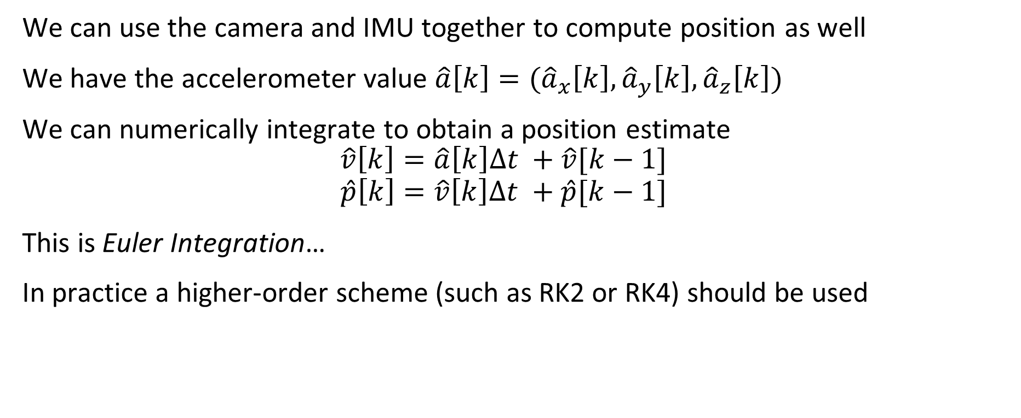
Integrating the Accelerometer
We can use the camera and IMU together to compute position as well
We have the accelerometer value $\hat{a}\left[k\right]=({\hat{a}}_{x}\left[k\right],{\hat{a}}_{y}\left[k\right],{\hat{a}}_{z}\left[k\right])$
We can numerically integrate to obtain a position estimate
$$\hat{v}\left[k\right]=\hat{a}\left[k\right]Δt +\hat{v}[k−1]$$
$$\hat{p}\left[k\right]=\hat{v}\left[k\right]Δt +\hat{p}[k−1]$$
This is Euler Integration…
In practice a higher-order scheme (such as RK2 or RK4) should be used

Slide 43
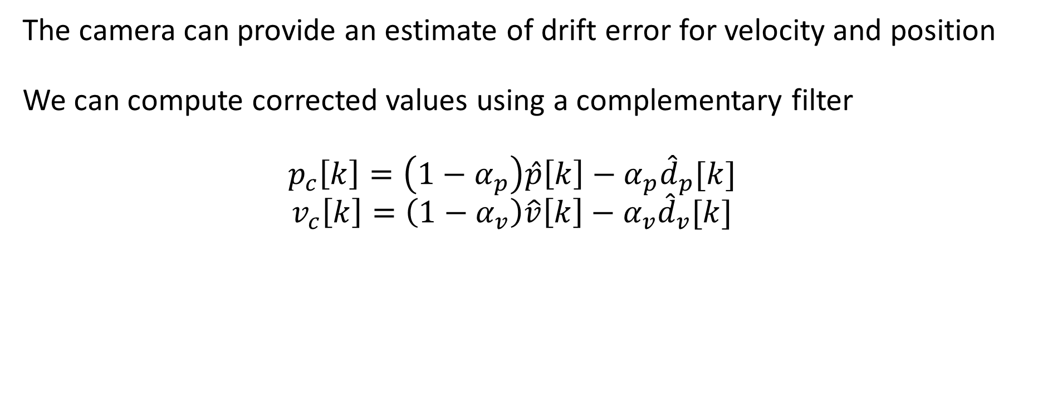
Correcting the Estimated Velocity and Position
The camera can provide an estimate of drift error for velocity and position
We can compute corrected values using a complementary filter
$$p_{c}\left[k\right]=\left(1−α_{p}\right)\hat{p}\left[k\right]−α_{p}{\hat{d}}_{p}[k]$$
$$v_{c}\left[k\right]=\left(1−α_{v}\right)\hat{v}\left[k\right]−α_{v}{\hat{d}}_{v}[k]$$

Slide 44
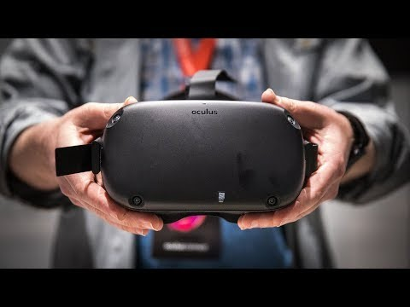
Oculus Quest

